Slide 1
De Morgan’s Law
Ramon Ramirez
Fidel Garcia
Antonio Maldonado
Jeffrey Lansford
Brandon Ihlein

Slide 2
What is De Morgan’s Law
De Morgan’s Laws are a pair of logical equivalences that show how to correctly distribute a negation operation inside a parenthesized expression
-First De Morgan’s law is: ¬(p ∨ q) ≡ (¬p ∧ ¬q)
-Second De Morgan’s law is: ¬(p ∧ q) ≡ (¬p ∨ ¬q)
-In set theory, the laws relate the intersection and union of sets through complements.
-In propositional logic, the laws relate the conjunctions and disjunctions of propositions using negation.
-In engineering, the laws are applied to develop logic gates for circuits, making them simpler and cheaper to produce.

Slide 3
Practical Examples
Java Programming Language
boolean x = true/false, y = true/false;
if( !(x && y) ){
//do stuff
}
&& - AND
|| - OR
! - NOT

Slide 4
Practical Examples (cont’d)
Using De Morgan’s law...
if ( !(x && y) ) is equivalent to if ( !x || !y )
This concept (along with other propositional logic rules) can be used to break down larger if-statements.
x | y | !(x /\ y) | !x \/ !y
T | T | F | F
F | T | T | T
T | F | T | T
F | F | T | T

Slide 5
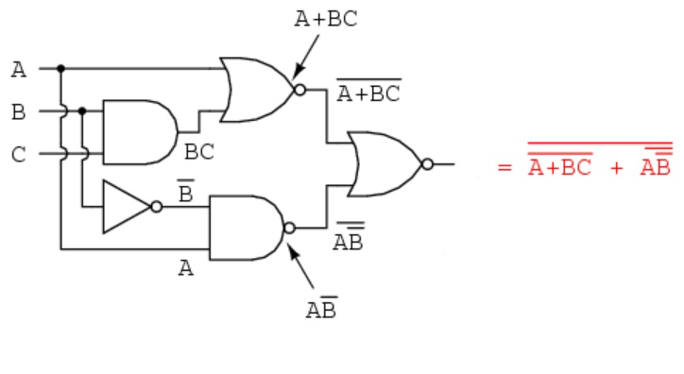
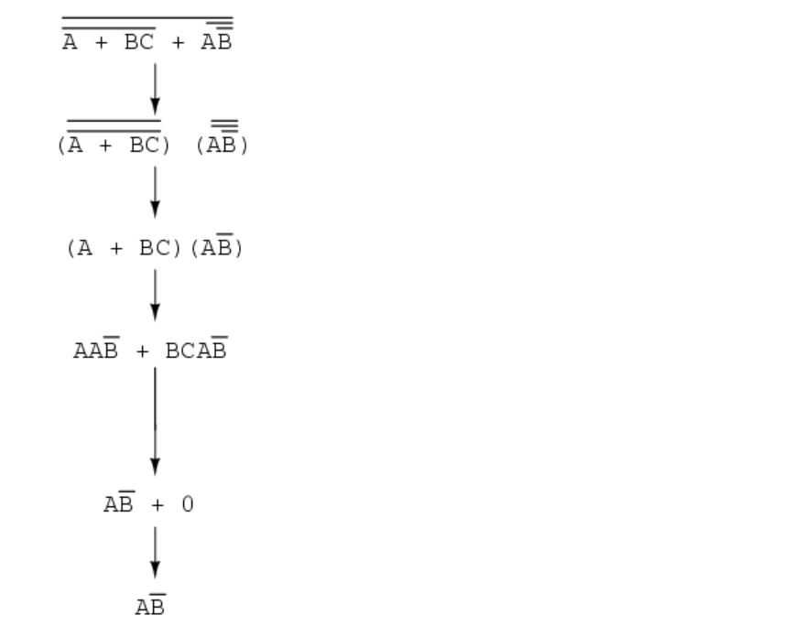

De Morgan’s Law and Circuits
Used to Simplify Circuits making them cheaper to produce and more efficient

Slide 6
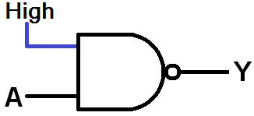
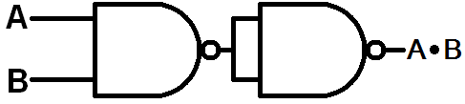
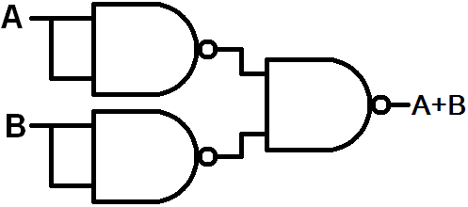
De Morgan’s Law and Circuits (cont’d)
We can use De morgan's to make circuits use only NAND gates
We can express NOT gates
We can express OR gates
We can express AND gates

Slide 7
De Morgan’s Law w/ Sets
Set U = {1, 2, 3, 4, 5, 6, 7, 8, 9, 10}
Set A = {2, 3, 5, 7, 8, 9}
Set B = {2, 4, 5, 8, 10}
According to De Morgan’s Law: ‘(A n B) = (‘A U ‘B )
Left Hand Side: Right Hand Side:
= {2, 5, 8}’ = {1, 4, 6, 10} U {1, 3, 6, 7, 9}
= {1, 3, 4, 6, 7, 9, 10} = {1, 3, 4, 6, 7, 9, 10}
Since the L.H.S. and the R.H.S are the same we can conclude that both side are equivalent.

